Slide 1

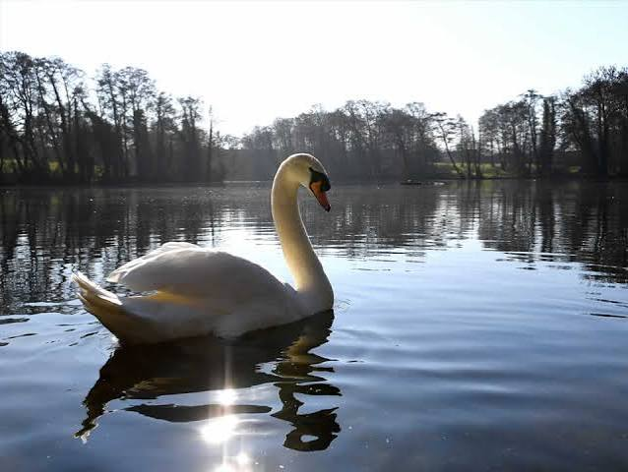
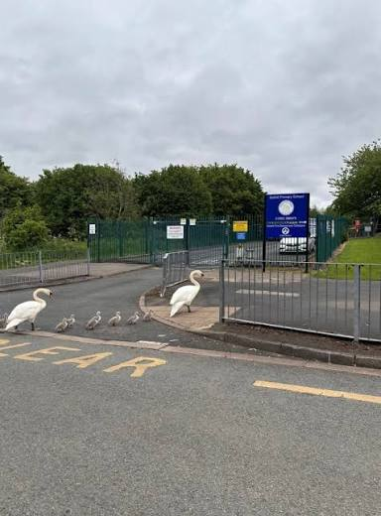
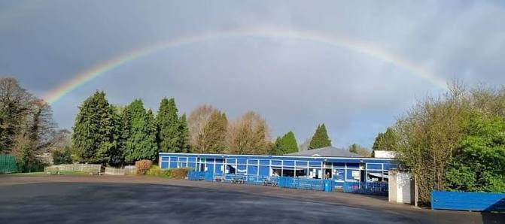
Welcome to Year 6

Slide 2
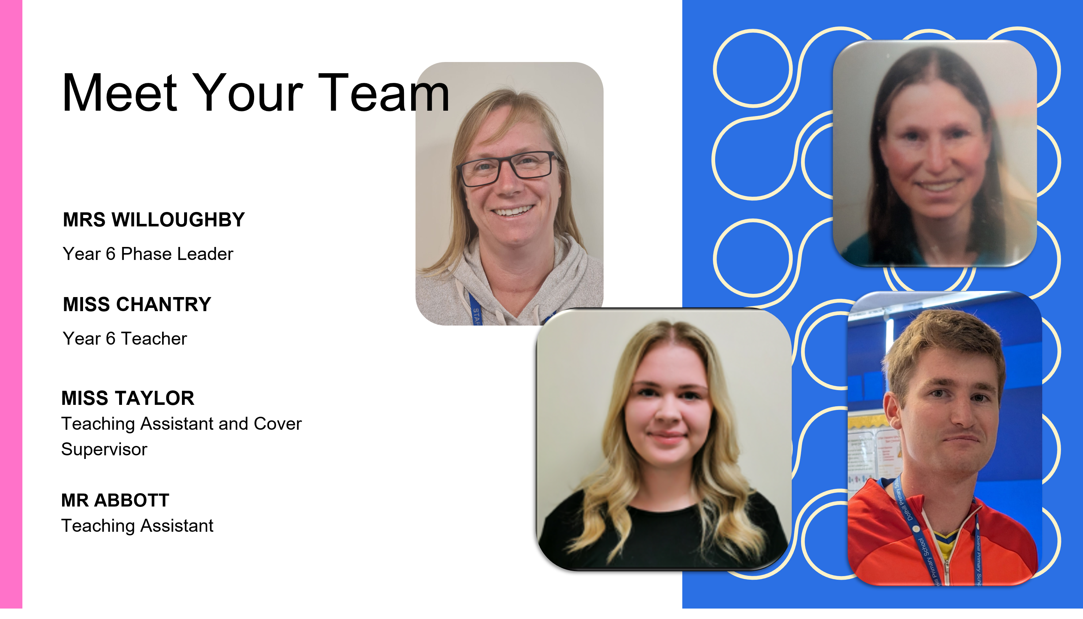

Slide 3
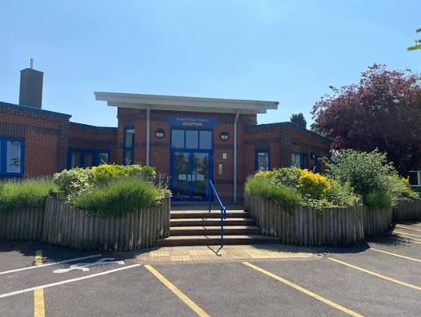
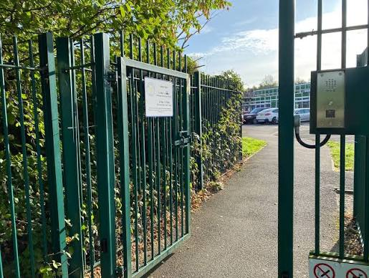
School Routines
Start of the Day
School gates open at 8:30am and children must be in the classroom by 8:45am.
Children enter school independently and are greeted by staff.
Coats, bags and water bottles are put away.
Registration takes place promptly.
Early morning activities help children settle into learning straight away.
Please ensure your child arrives on time every day.
During the School Day
Lessons follow a structured timetable
Regular opportunities for reading, writing and maths.
Morning break and lunchtime routines
Children are encouraged to follow our school values and the Ready, Respect, Safe expectations.
Water bottles should be brought to school daily.
End of the Day
Children are dismissed from their classroom door or designated collection point.
Please wait in the agreed collection area and inform the office of any changes to collection arrangements.
Children walking home independently must have written parental permission.
Mobile phones brought to school by authorised pupils are collected from staff at the end of the day.

Slide 4
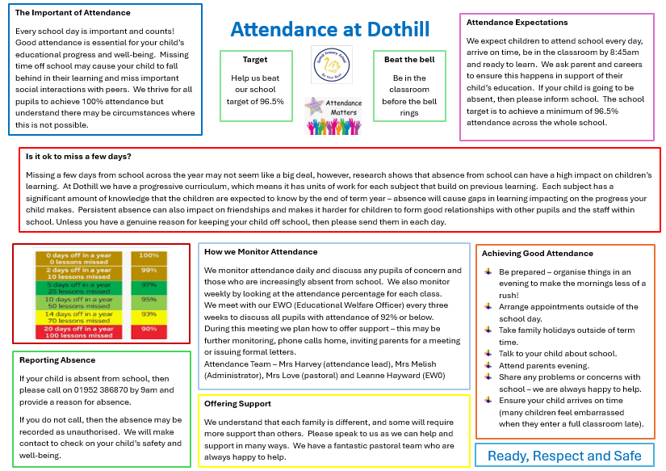

Slide 5
About Our Class
We do not encourage bringing mobile phones to school – school does not accept liability for them.
Phones brought in will be collected at the door and stored in the school office throughout the day. Children will need to remember to collect them from class before leaving for home.
Mobile Phones are not allowed to be used on the school premises. They should be turned off, when children enter the site.
Year 6 is a very independent year.
Children usually bring themselves to school, and MUST be here before 8:45am. Each day starts at 8:30am with ‘morning maths’ so please encourage your child to arrive in time for this.
PE is on Wednesdays for 6C, and Thursdays for 6W
PE kit should be worn to school on those days.
PE kits must be plain and appropriate – see the school website for specifics.
Jewellery must be removed (best not to wear earrings on PE days)
Hair must be tied up if long enough.
In preparation for secondary school, homework is an expectation and non-negotiable.
All Y6 pupils must:
read 4 times a week and sign the diary
complete TTRS
Practise spellings twice a week.
Any homework not evidenced will be expected to be completed during Friday morning breaktime – think detention in secondary school!

Slide 6
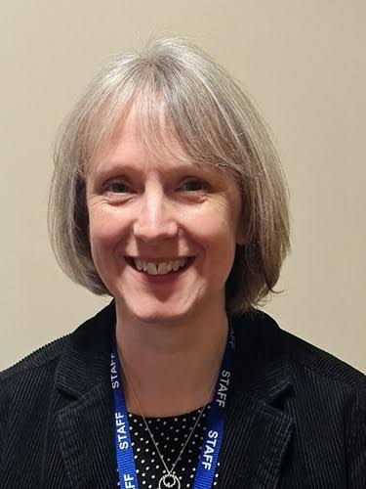
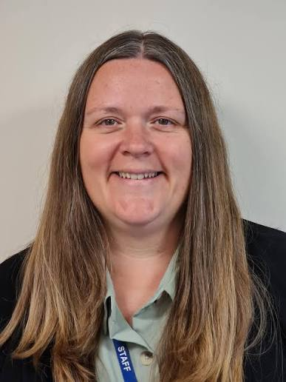
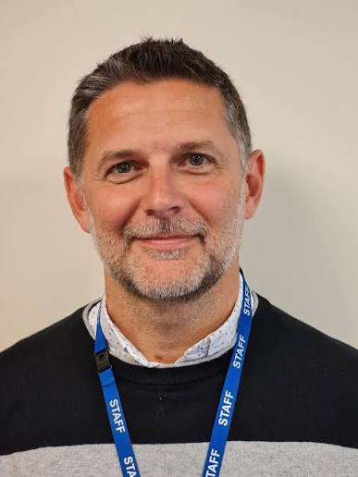
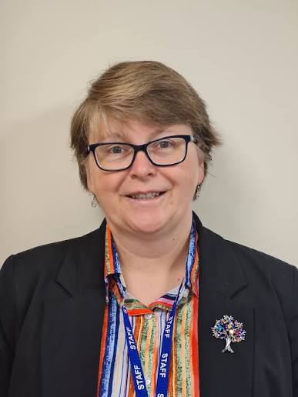
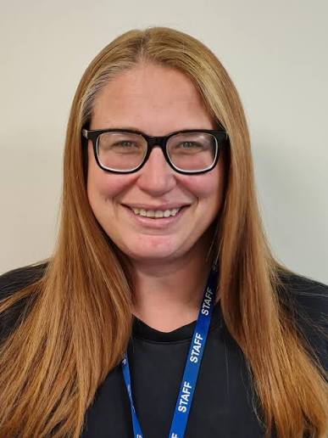
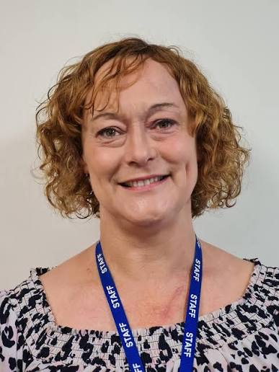
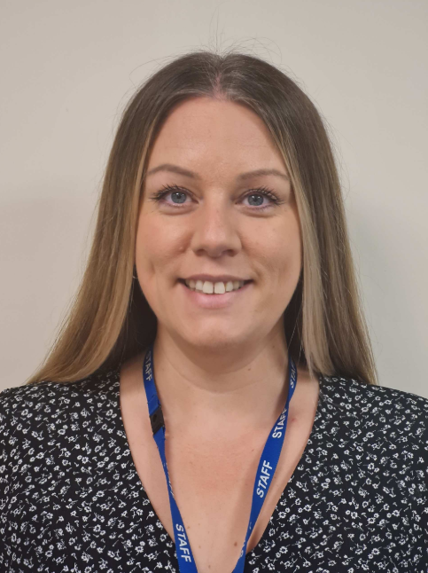
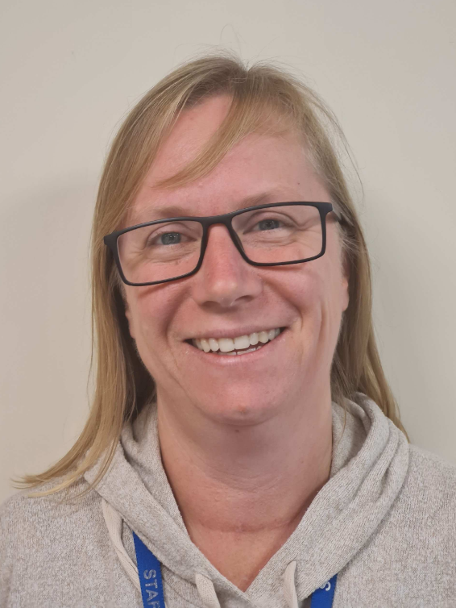
Meet the Wider Team and key responsibilities
Mrs Thomas Head Teacher | Mrs Harvey Deputy Head | Mr Kirkpatrick Assistant Head | Miss Brotherton Assistant Head | Miss Love Pastoral | Mrs Sturmey Learning Mentor | Mrs Wood | Mrs Willoughby
Lead DSL Governance | Deputy DSL Attendance Curriculum Behaviour Nurture | Deputy DSL Y3/4/5 Leader Maths | Deputy DSL SENCo Rainbow Room Y1 / 2 Leader | Deputy DSL Early Help Nurture | Deputy DSL Early Help ELSA Mental Health Lunch (with Phil the dog!) | EYFS Leader | Y6 Leader English
DSL – Designated Safeguarding Lead; SENCo – Special Educational Needs Coordinator; ELSA – Emotional Literacy Support Assistant
Phase leaders (marked blue) have a dedicated email if you need to be in touch with them rather than the class teacher. Please see the website for these.

Slide 7
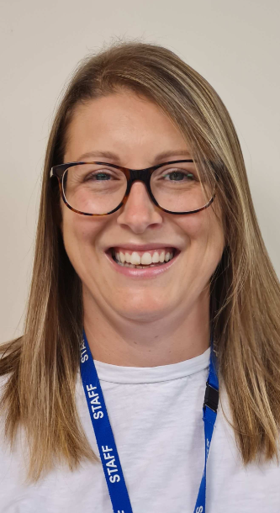
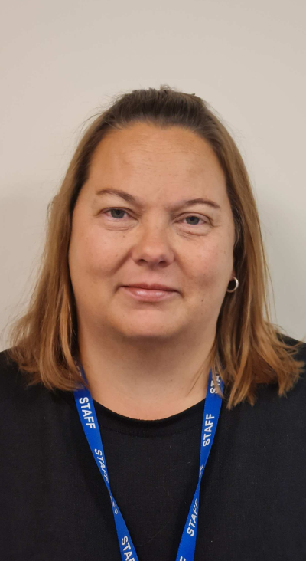
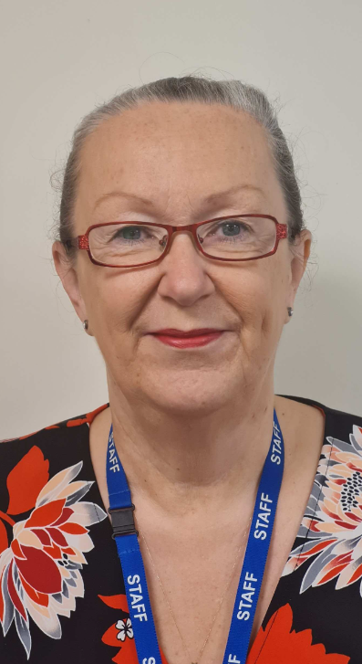
Office Staff
School Contact Information
General Enquiries – Lorna or Nicola (admin team)
Telephone - 01952 386870
Email - dothill@taw.org.uk
SEND Email - dothill.primarysend@taw.org.uk
Mrs Nicola Hughes | Mrs Lorna Mellish | Mrs Julie Thornton School Business Manager

Slide 8

Communication
In Person
Daily contact with SLT who will be on the gates
Teacher / TAs on the classroom door each day
Email
Letters
Weekly Newsletter
School Website
Weekly Newsletter (News and Events section)
Class Page updates (see Parents section)
Contact Us
Telephone and email
Phase leader email
(See Contact Us page of website)

Slide 9
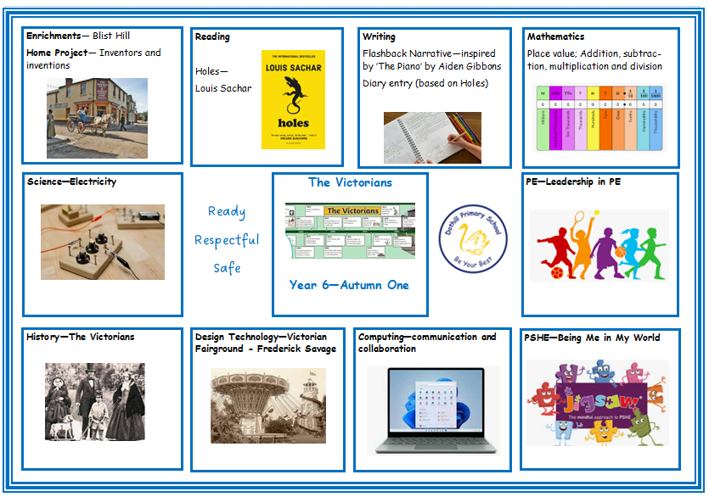
Curriculum Overview

Slide 10
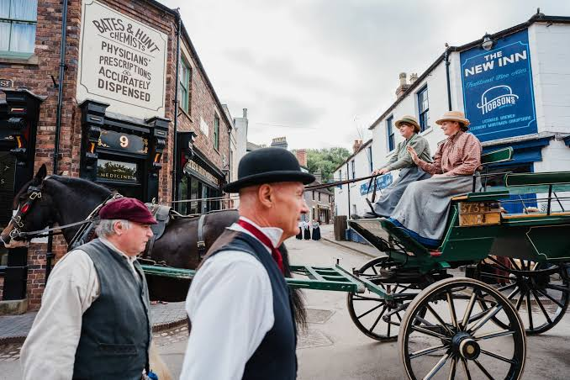
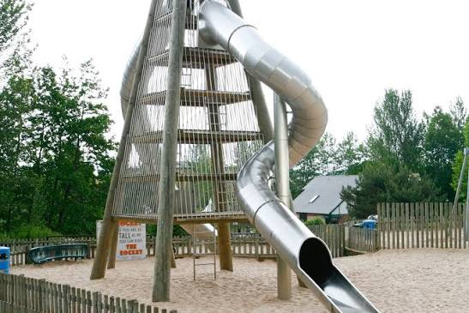
Enhancements
Autumn Term:
Blists Hill
Telford Town Park
Spring Term:
Arthog/Activities week
Nature Reserve
Summer Term:
Carding Mill Valley
Visits from Spiritual Leaders
Crucial Crew

Slide 11
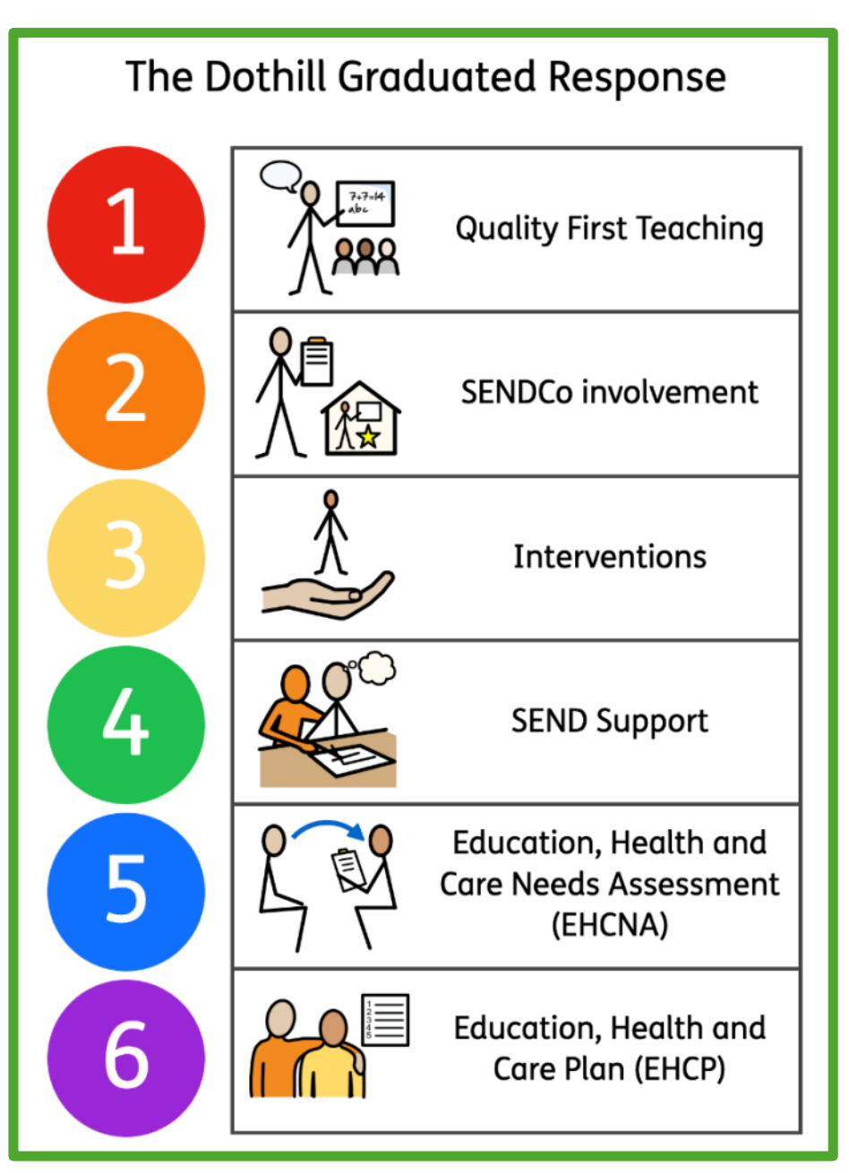

SEND
Our Graduated Response supports children at every stage of their learning journey. Quality First Teaching in every classroom helps to identify areas children who may need additional help.
As SENDCo, Miss Brotherton may carry out observations or direct work with your child following discussions with parents and staff. This helps us to identify next steps for your child and may involve referrals for help from other professionals.
In response to the very latest Government recommendations, the structure of the UK SEND system is changing, meaning quicker routes to support through schemes such as 'Experts at Hand'. Other new terminology will be appearing over the school year and we will be happy to navigate this with you.
We work closely with nurseries and pre-schools to ensure your child starts school confidently and with the best possible provision. We also work with secondary school staff to ensure that transitions are as smooth as possible. For children moving up into their next year groups, SEND information is carefully handed over so that your child has a smooth transition.
We will continue to offer more SEND coffee meets, offering parents the opportunity to chat informally with our SENDCo and with support workers from bodies such as PODS, the Tourette’s Action Group, Family Hubs and Telford Autism Hub. Dates for these are advertised in our weekly school newsletter, alongside various SEND articles for families.
Our first SEND coffee morning is on 29th September – hope to see you there!

Slide 12

Reading at Home: Working Together
Why is daily reading important?
Regular reading builds fluency, confidence, vocabulary and comprehension.
We expect children to read at least 4 times per week, but daily reading is even better.
Children will bring a reading book home from school, but they are welcome to read books from home as well.
Reading Records
Please sign your child's reading record each day they read.
Reading records help us celebrate progress and support reading habits.
Book Changing
Reading books can be changed daily through the class library.
From Year 2 onwards, children also:
Visit the school library weekly with their class and have access to the library during one lunchtime each week.
Reading Expectations at Home
Younger children: Read aloud to an adult for 10-20 minutes each day.
Older children: May read independently, but adults should discuss the book with them and explore any unfamiliar vocabulary.
Read Write Inc. (RWI)
Children on the RWI programme will bring home:
  2 RWI books matched to the sounds they have learned. 1 sharing book to enjoy together.
RWI books should be practised and read aloud repeatedly.
Sharing books may be too challenging to read independently and are intended to develop a love of stories and reading.

Slide 13
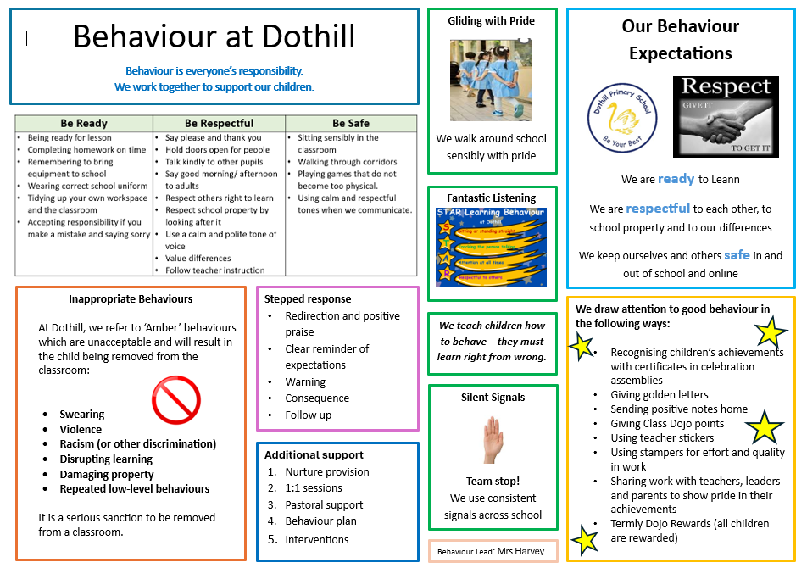

Slide 14
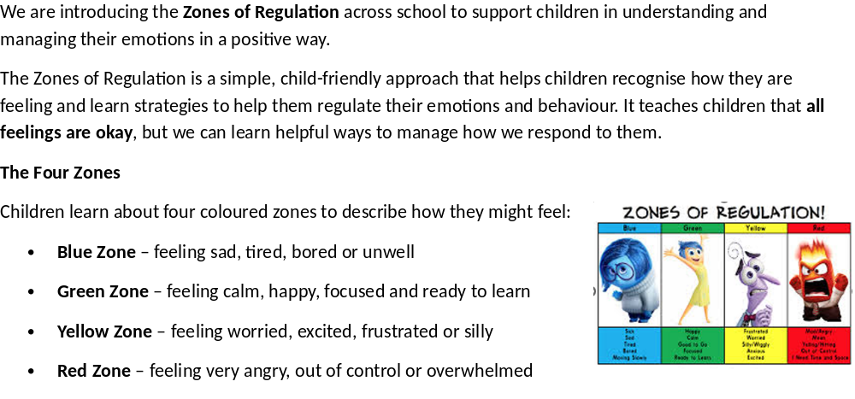
Zones of Regulation

Slide 15
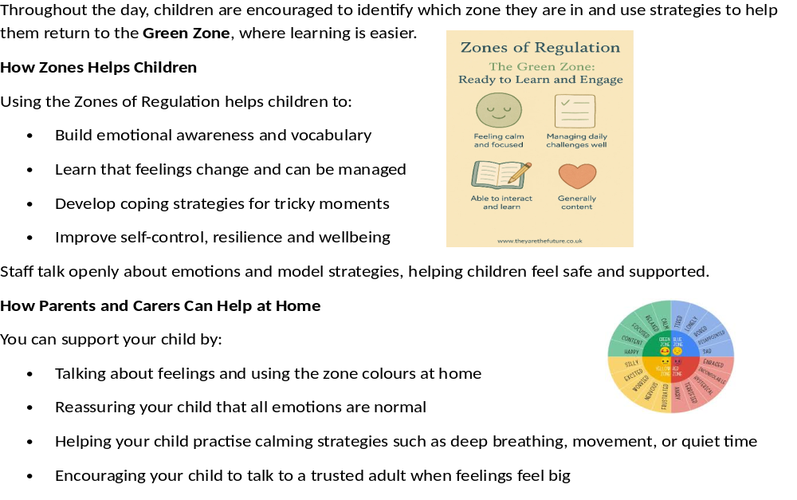

Slide 16


Key Dates
These are always published on the school website and weekly newsletter
Up and coming events for the Autumn Term
School photos 15.9.26
Year 6 SATs meeting 18.9.26
Year 4 MTC meeting 22.9.26
SEND Coffee morning 29.9.26
Grandparents Tea Party 5.10.26
Diversity Week WB 12.10.26
Open Afternoon 19.10.26
Coffee Morning 24.11.26
Year 5 Christmas Event 1.12.26
Year 4 Christmas Event 2.12.26
Year 3 Christmas Event 3.12.26
EYFS Stay and Play 4.12.26 /11.12.26
Year 6 Christmas Event 8.12.26
KS1 Christmas Performance 9.12.26 at 2pm / 10.12.26 at 9:15am
Dojo Reward Afternoon 14.12.26
Christmas dinner 16.12.26

Slide 17
How Parents Can Help
Read daily
Practise times tables/ number facts
Encourage independence
Ensure good attendance
Talk positively about learning
Read weekly newsletter
Check emails for school communications
Inform school of any key changes at home
Share any concerns

Slide 18


