Slide 1

Year 6 SATs Information Evening
Supporting Your Child's Success

Slide 2
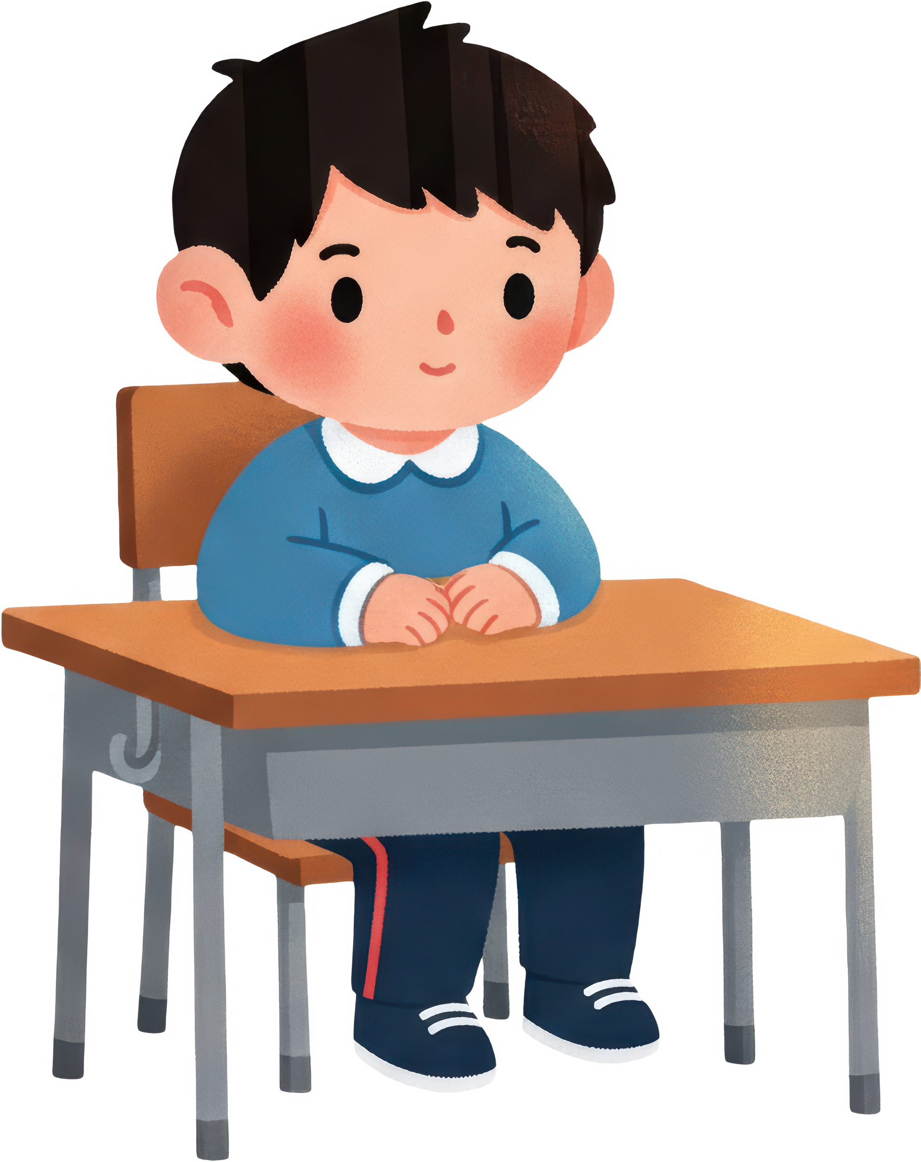
What Are SATs?
SATs are national assessments for Year 6 students that evaluate their knowledge in core subjects.
Understanding SATs helps parents support their children effectively during this important academic milestone.

Slide 3
Test Timetable
SATs will take place during the week of 10th May 2027.
What to Expect During SATs
Assessments
Students will complete reading, writing, and mathematics assessments.
Outcomes
Results will provide insights into student progress and are used as baselines for secondary school.
Results will be published in your child’s end of year report in July.

Slide 4
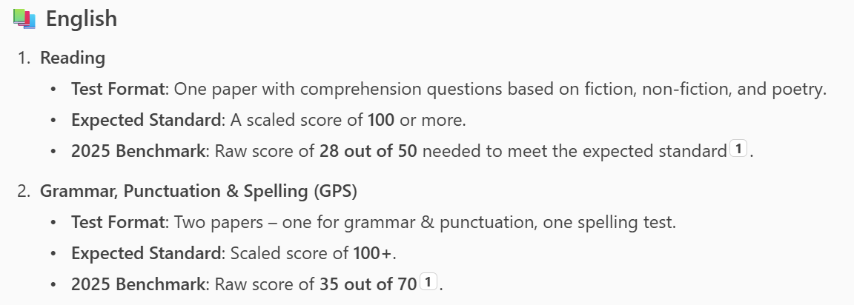
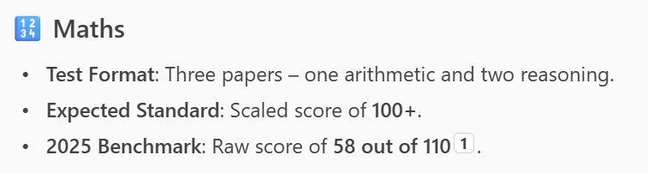
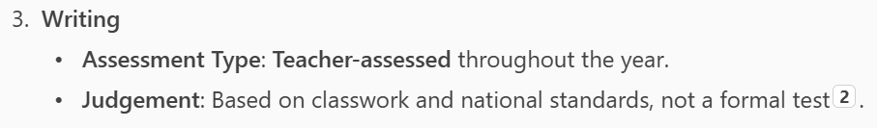
What to Expect from the tests

Slide 5
SATs results - know what you are aiming for!
Scaled Scores Range: 80 to 120.
100 = Expected standard.
110–120 = Exceeding expectations.
80–99 = Working towards the expected standard
These are accompanied by a statement of whether your child HAS MET or HAS NOT MET the expected standard.
There will also be a separate judgement of writing, described as WORKING TOWARDS THE STANDARD, WORKING AT THE STANDARD or WORKING AT GREATER DEPTH

Slide 6


Preparing for SATs: School and Home
School Preparation
Home Preparation
We will teach the curriculum content, model the standards expected and teach the students how to best approach the tests.
We will try to stike a balance between motivation, ambition and effort, alongside managing stress and anxiety.
Encourage regular study routines and positive reinforcement
Practice, practice, practice.
Talk to school about any anxiety.

Slide 7



How Parents Can Support Their Children
Routines, Sleep, Positivity
At School: Communication, Encouragement
  Stay in touch
  Encourage participation
  Celebrate small achievements
  Set a routine
  Ensure adequate sleep
  Foster a positive mindset
  Encourage websites such as BBC bitesize
  Buy and reward them for using revision guides and workbooks
School will be making some available to buy through ParentPay – this gets you them at the reduced school cost, rather than published price.

Slide 8
Booster sessions
In School:
After School:
  We will set optional homework each week for those who have purchased the workbooks.
  If you bring the completed work in on a Friday, we will check it and catch-up in school time with anyone making errors or needing help.
  We will break out into smaller targeted groups for some time in the afternoon to complete extra revision and practice.
  We will be running small booster groups after school to target specific needs.
  Initially, these will be invitation only, so we can match the activity closely to need.
  As we get closer to SATs, we will open these up to anyone who wishes to complete extra practice and preparation.

Slide 9
“With support, every child can achieve their best”

Slide 10
We’re Here to Help –
Come to the classroom door at the end of the day.
Email:
dothillphaseleaderUKS2@taw.org.uk

